Slide 1
Work Ethics
Vivek Garg
CSVTU Bhilai

Slide 2
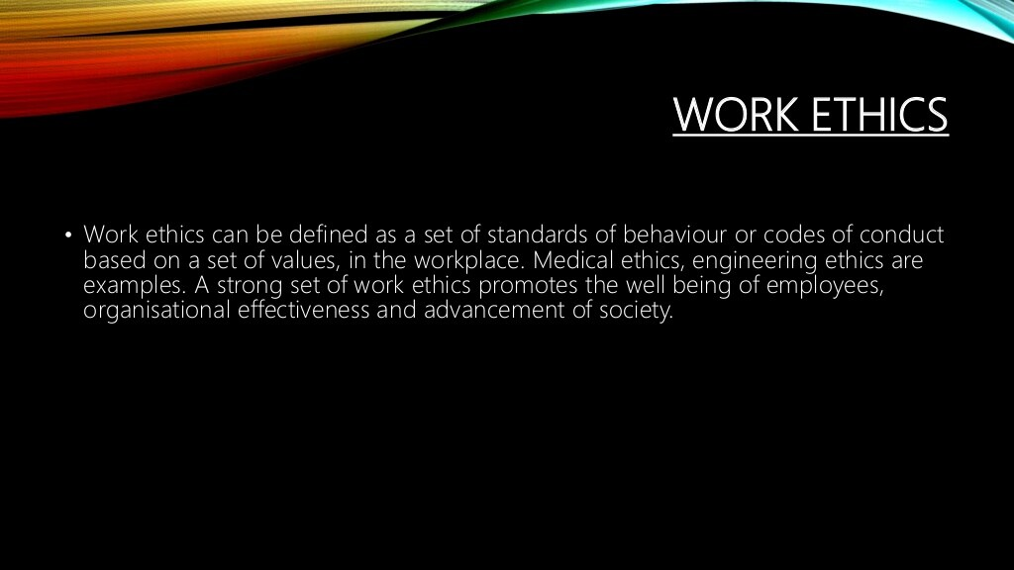

Slide 3
Work Ethics
Work ethics is defined as a set of attitudes concerned with the value of work, which forms the
motivational orientation. The ‘work ethics’ is aimed at ensuring the economy (get job, create wealth, earn salary), productivity (wealth, profit), safety (in workplace), health and hygiene (working conditions), privacy (raise family), security (permanence against contractual, pension, and retirement benefits), cultural and social development (leisure, hobby, and happiness), welfare (social work), environment (anti-pollution activities), and offer opportunities for all, according to their abilities, but withoutdiscrimination.

Slide 4


Slide 5


Slide 6


Slide 7
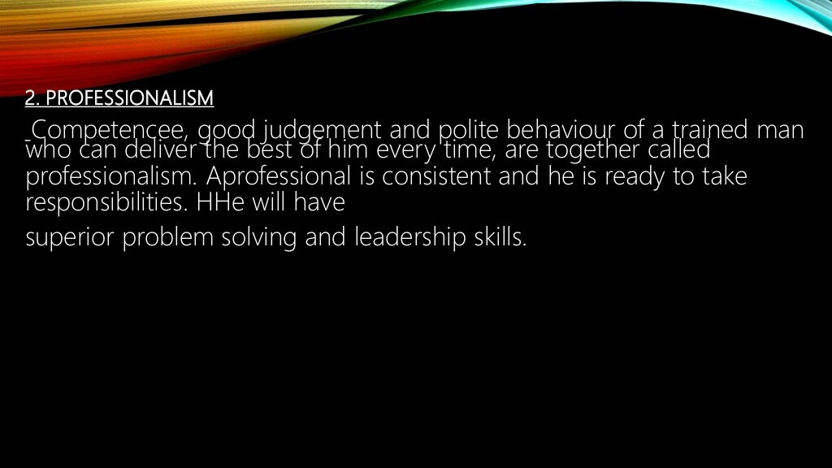

Slide 8
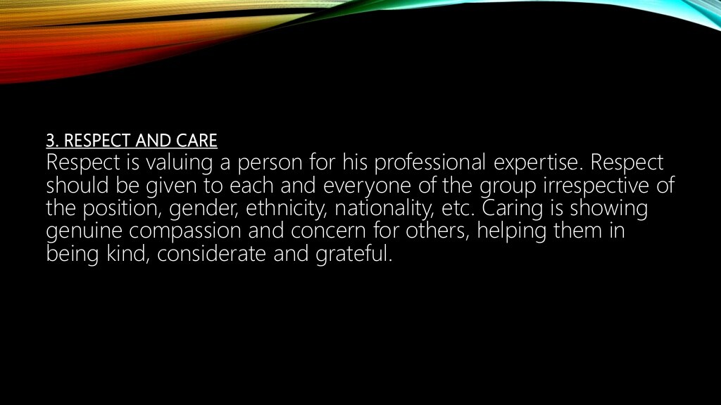

Slide 9
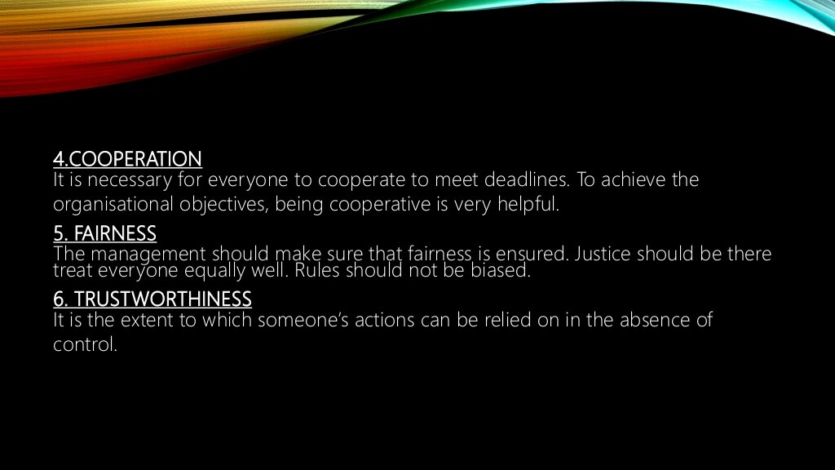

Slide 10


